Slide 1
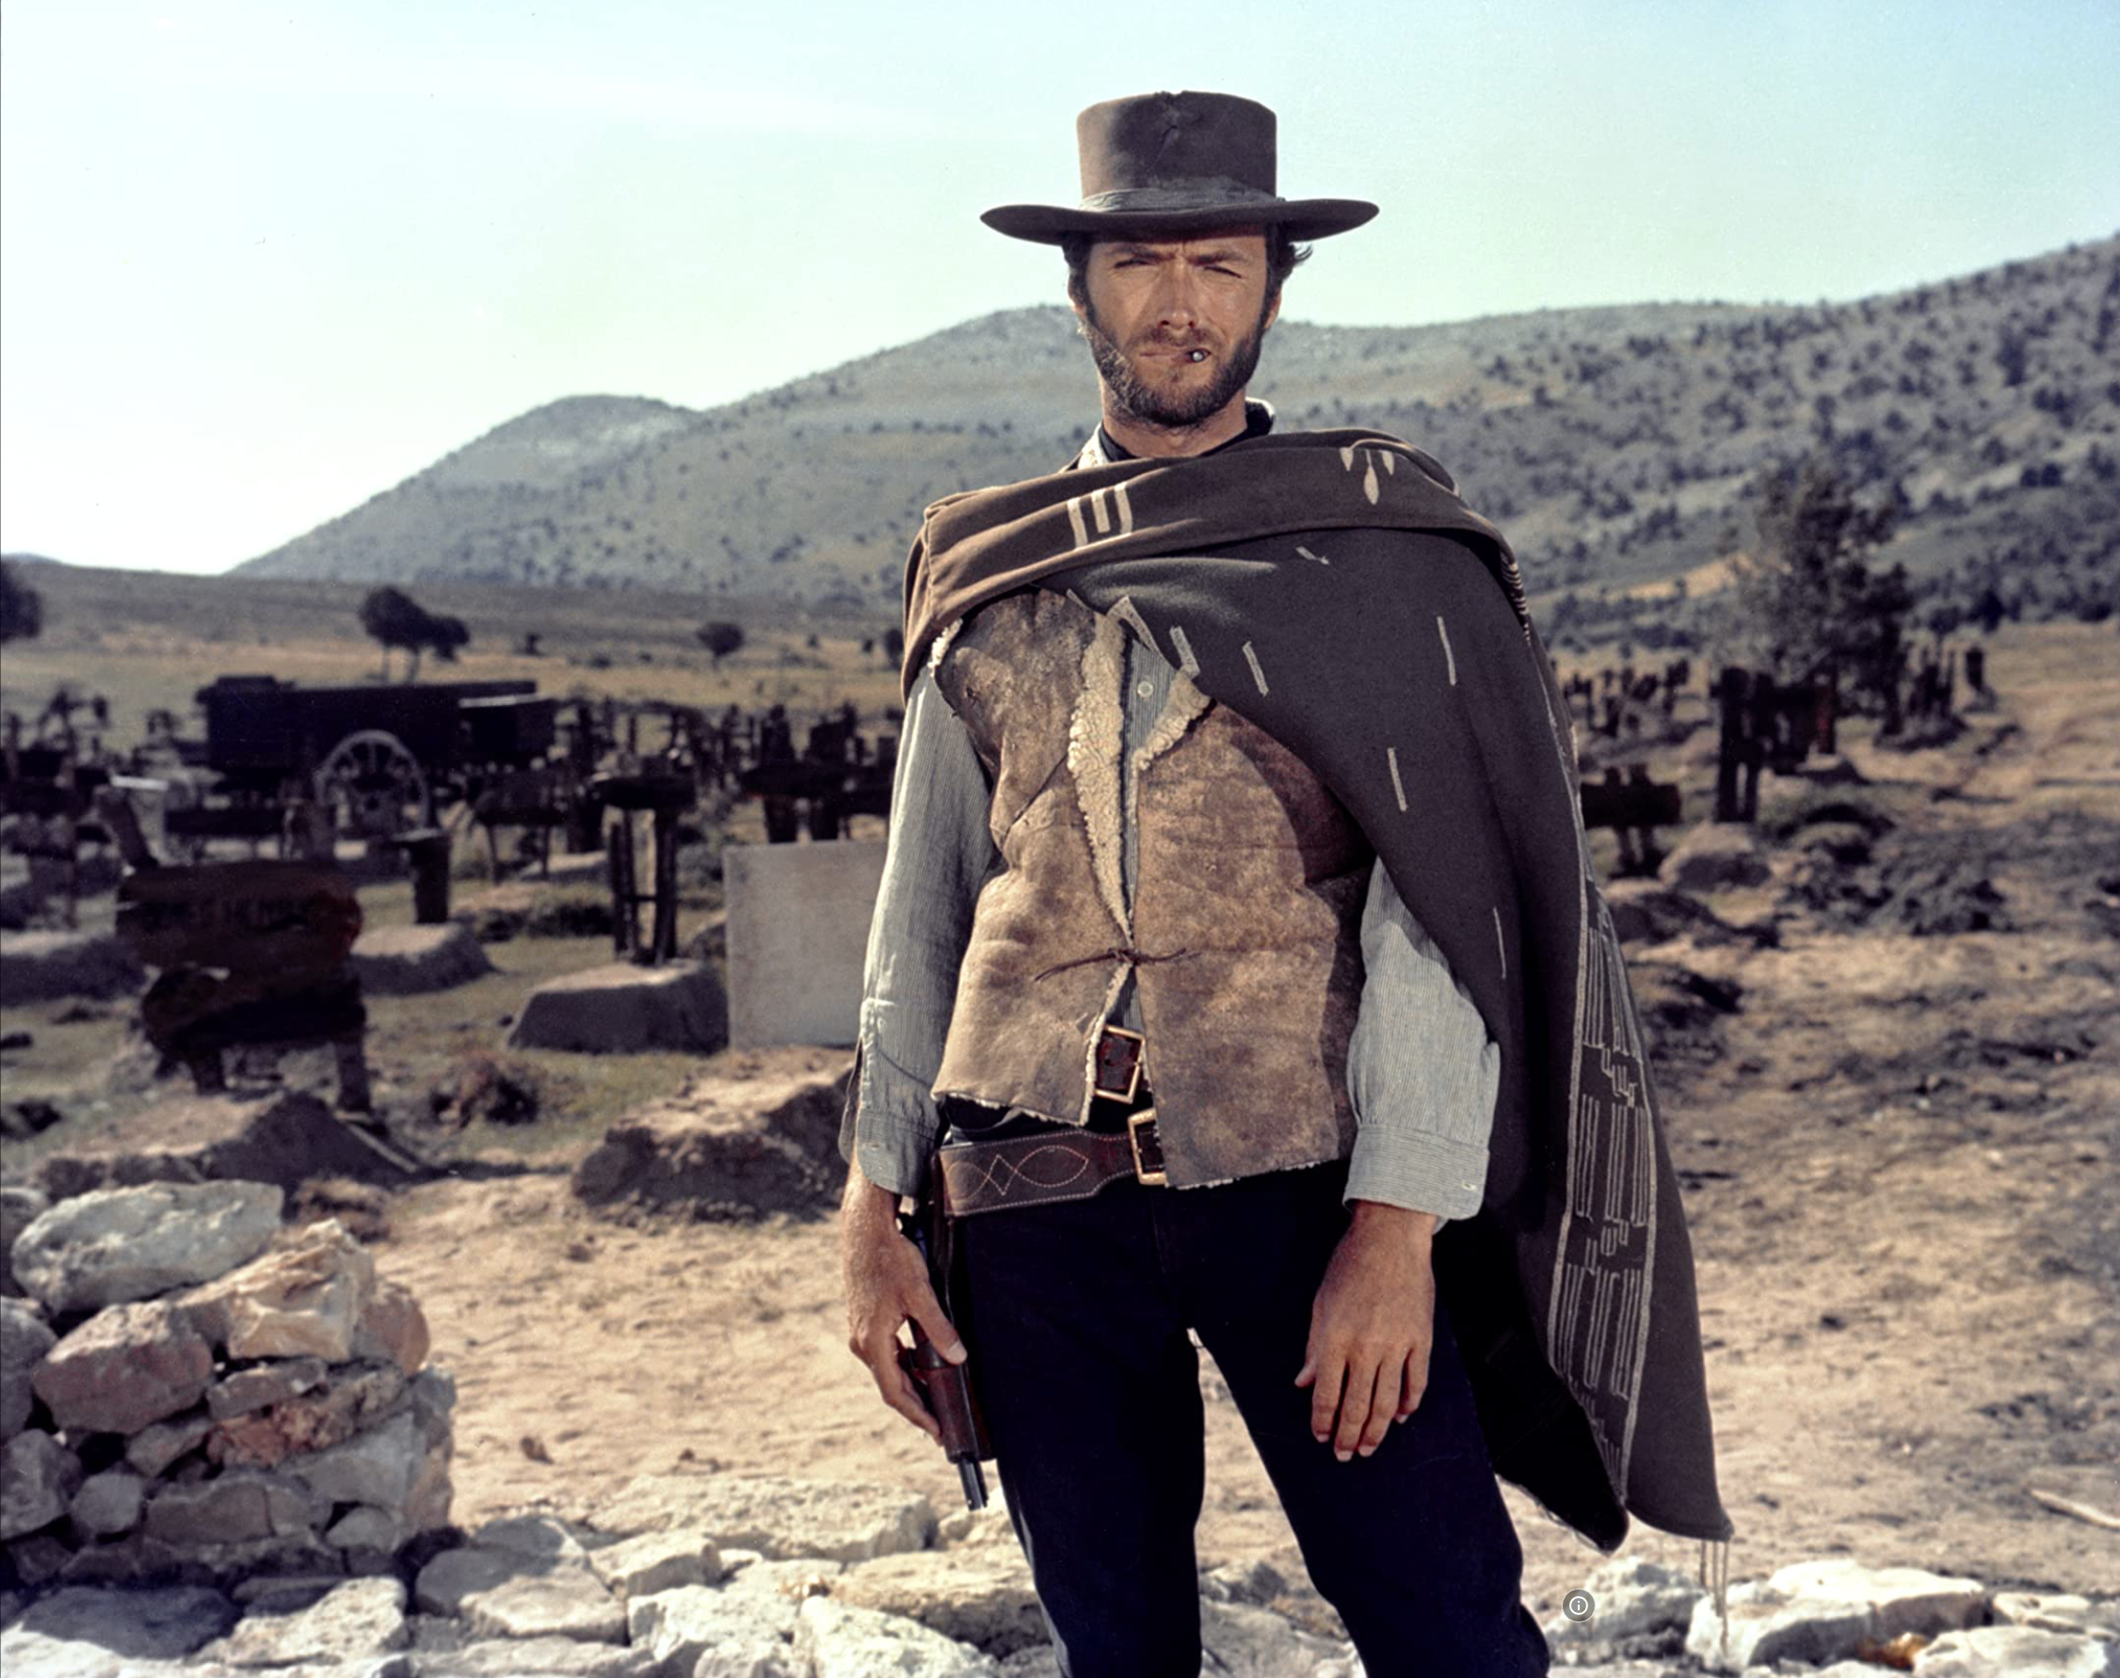

The Easy, the Hard and the Ugly
Easy
Inference (fit)
Fine-Tuning (predict)
Hard
Pre-training
Ugly (Responsible AI)
Bias
Toxicity
Misinformation
Hallucinations
Plagiarism

Slide 2
Easy: Outline
NLP
prompt engineering
inference (predict)
fine-tuning (fit)
IR
Quick recap
1 slide on hard problems for researchers/practitioners

Slide 3
Easy - IR
Inverted index solutions
Elastic Search, Solr, Lucene
SQL-contains
Basic multilingual support
Out-of-the-box ranking
Simple 10-blue links with any UX framework
Lots of open-source solutions

Slide 4
Ranking models
Classical models
Boolean
Vector space
Probabilistic (BM25, LMs, Bayesian networks)
Web
PageRank
Hubs & Authorities
Neural
Semi-structured text

Slide 5
IR - Relevance evaluation
Metrics
Precision, recall, nDCG, etc.
Evaluate using gold set
Crowdsource with a budget
Simple click instrumentation

Slide 6
Easy: If you are a researcher or practitioner
What can you do right now
without too much effort
What other low hanging fruits are out there?
Research opportunities
Pros/Cons
Pointers to related work

Slide 7
Easy: Outline
NLP
prompt engineering
inference (predict)
fine-tuning (fit)
IR
Quick recap
1 slide on hard problems for researchers/practitioners

Slide 8
Prompt Engineering (and disintermediating web-search)
Super-Popular (100+ million users)
Most successful (rapid) adoption of any web app ever
Super-Easy
Easier than Fine-Tuning (and Inference)
Use Cases
“Helping” with homework:
Cheating (?)
Documentation:
Alternative to stack overflow

Slide 9

“Helping” with homework: Cheating (?)
Collaborate with students on essays
You have no idea how much we’re using ChatGPT
Cheating?
ChatGPT is better for some tasks
Good: thesis statements, outlines
Bad: capture student’s voice
Worse: quotes
Learning opportunity:
How to decompose writing to subtasks
Collaboration is great,
but student is responsible for end-product

Slide 10
Disintermediating Google
Google → Stackoverflow → Instant Answers → ChatBot

Slide 11
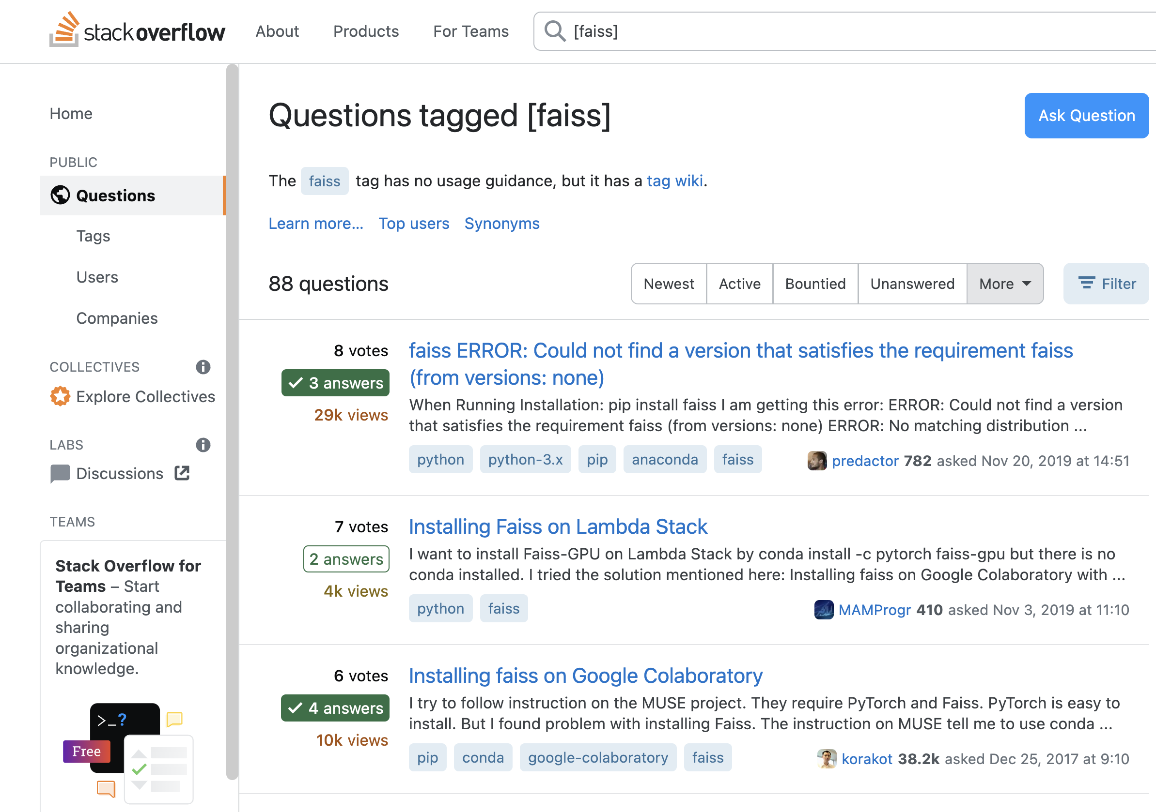

Slide 12
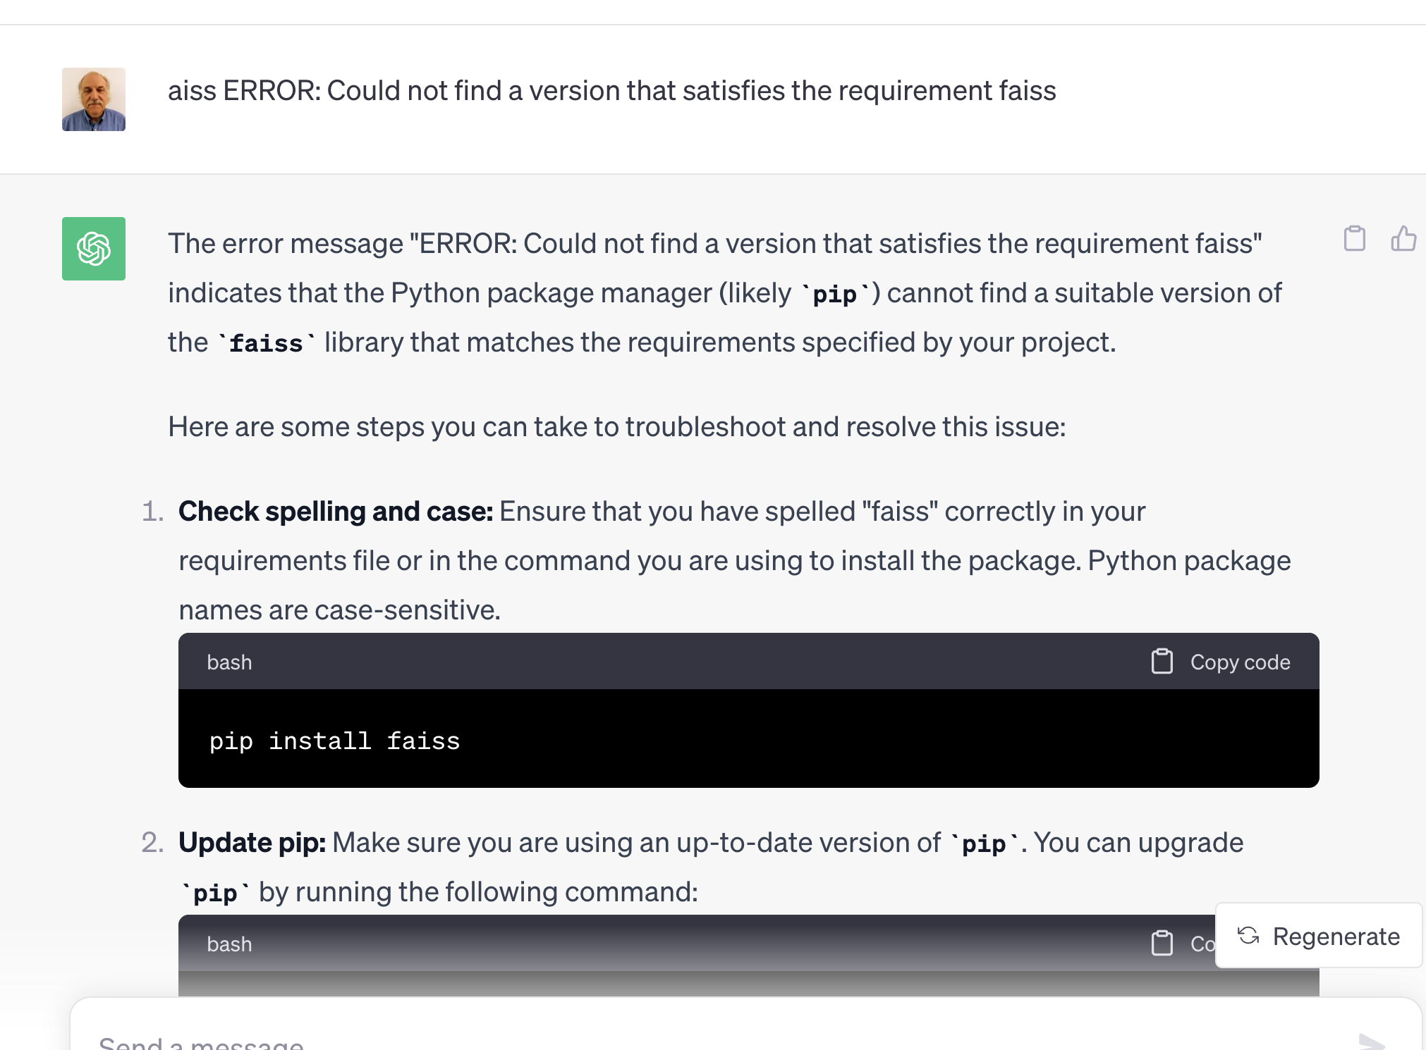
Replacing Stackoverflow with ChatGPT

Slide 13
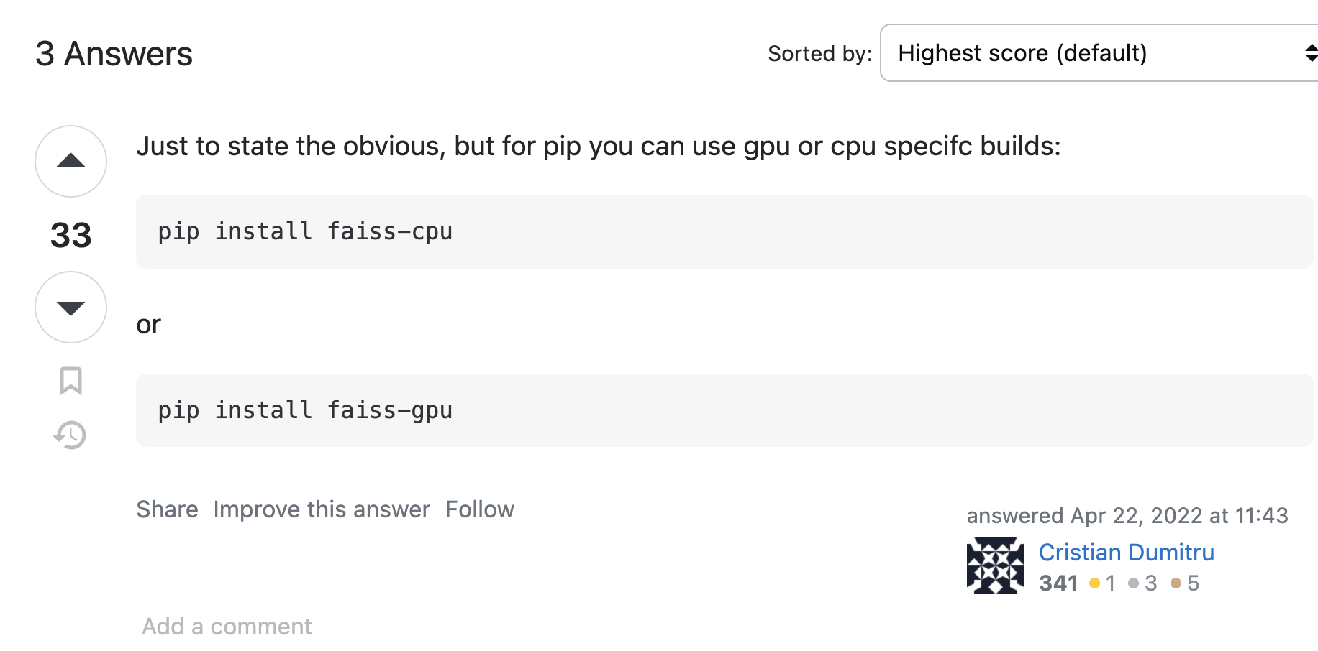
I may be old-fashioned, but I still use Stackoverflow…
Advantages of Stackoverflow
Behavioral signals: logs, votes
Wisdom of the crowd
Feedback to developers
Bug Reports
with stats (prioritization)
and workarounds (with votes)
Web search
Solitaire
Multi-player game (auction)
If we lose stackoverflow
Developers will suffer
Where does ChatGPT get its content?
Stackoverflow?

Slide 14
Example: Recommendations and Compare/Contrast

Slide 15
Recommendation Use Cases
For readers:
What should I read?
For authors:
What should I cite?
For conference organizers:
Who should review what?
Finding experts:
Who knows? (Streeter & Lochbaum, 1998)

Slide 16
Semantic Scholar API
https://api.semanticscholar.org/recommendations/v1/papers/forpaper/21321bad706a9f9dbb502588b0bb393cf15fa052?from=all-cs&fields=title,externalIds,citationCount
Semantic Scholar: A collection of 200M papers
query: 21321bad706a9f9dbb502588b0bb393cf15fa052
A paper id on Semantic Scholar
200M papers → Specter embeddings
BERT-like vectors with 768 hidden dimensions
Mostly encodes titles and abstracts (with some fine-tuning on citation graph)
from=all-cs: limits search to computer science
about 10% of their collection of 200M papers
uses FAISS to find approximate nearest neighbors for query

Slide 17
Need to explain these topics before getting into this example
BERT
Specter
Approximate Nearest Neighbors
FAISS

Slide 18
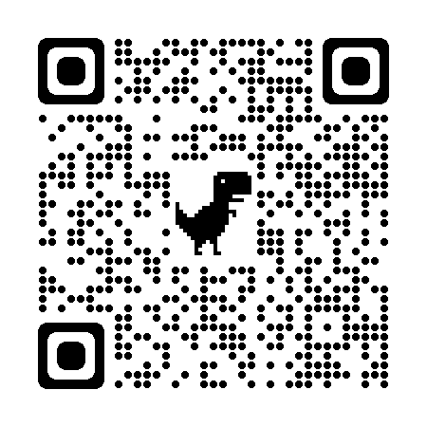
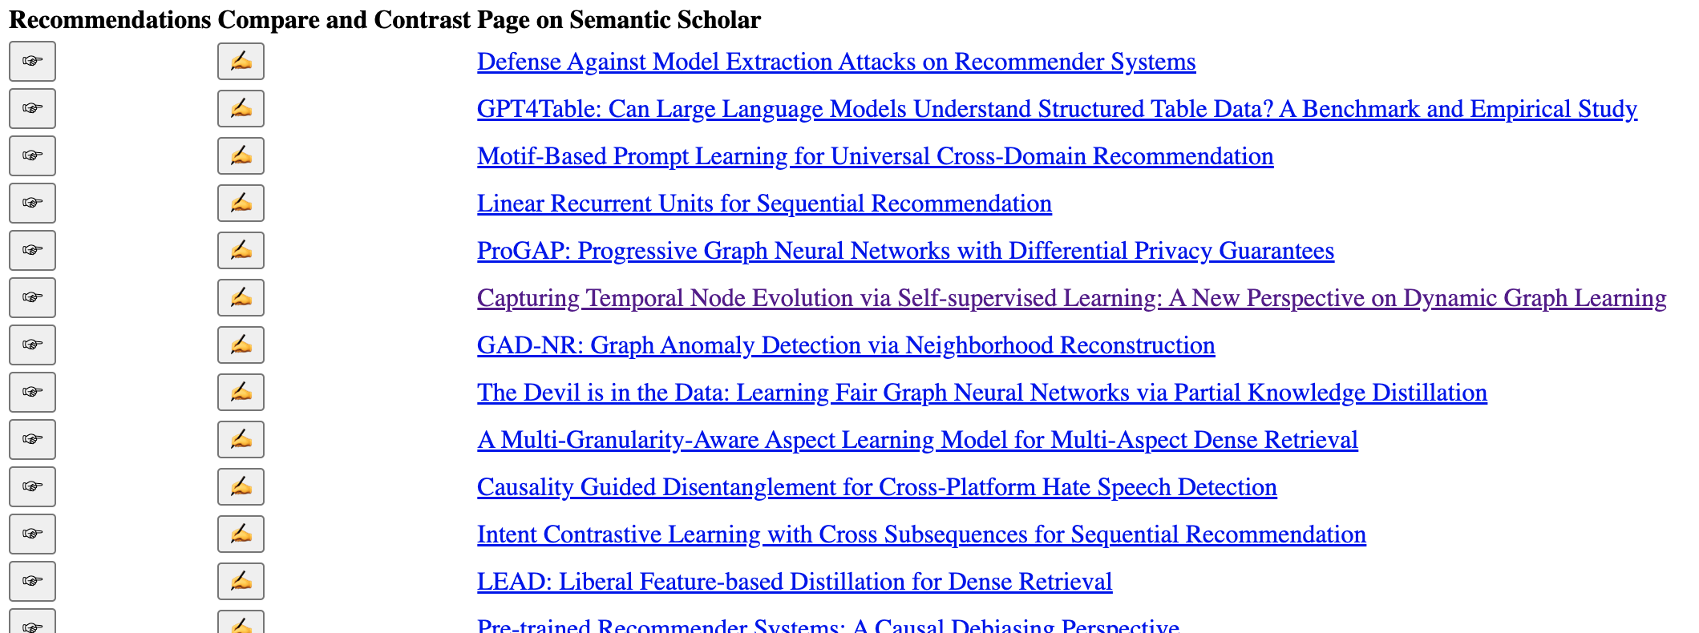
WSDM-2024 Papers on arXiv

Slide 19
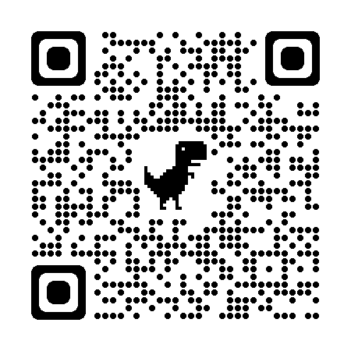
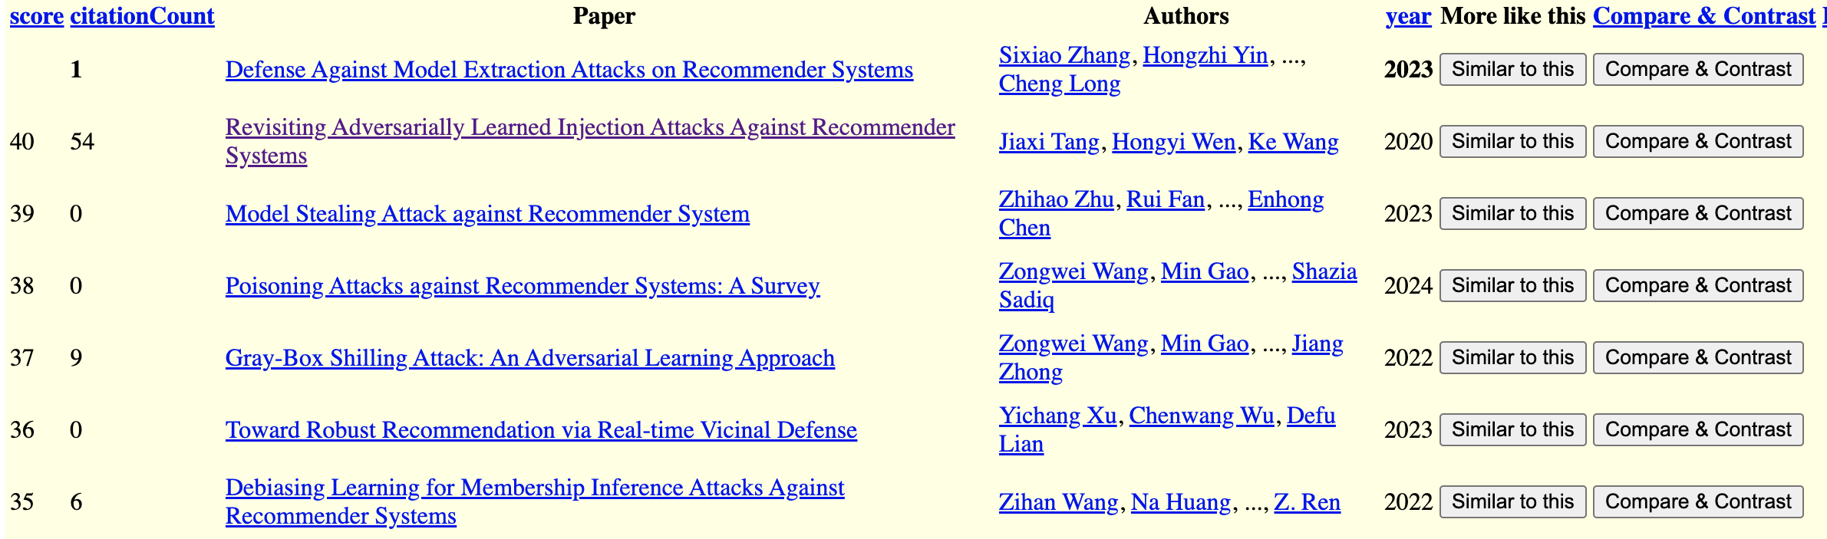
Recommendations for a Paper in WSDM-2024

Slide 20
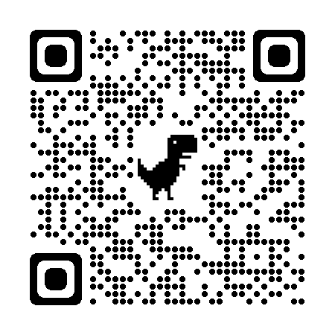
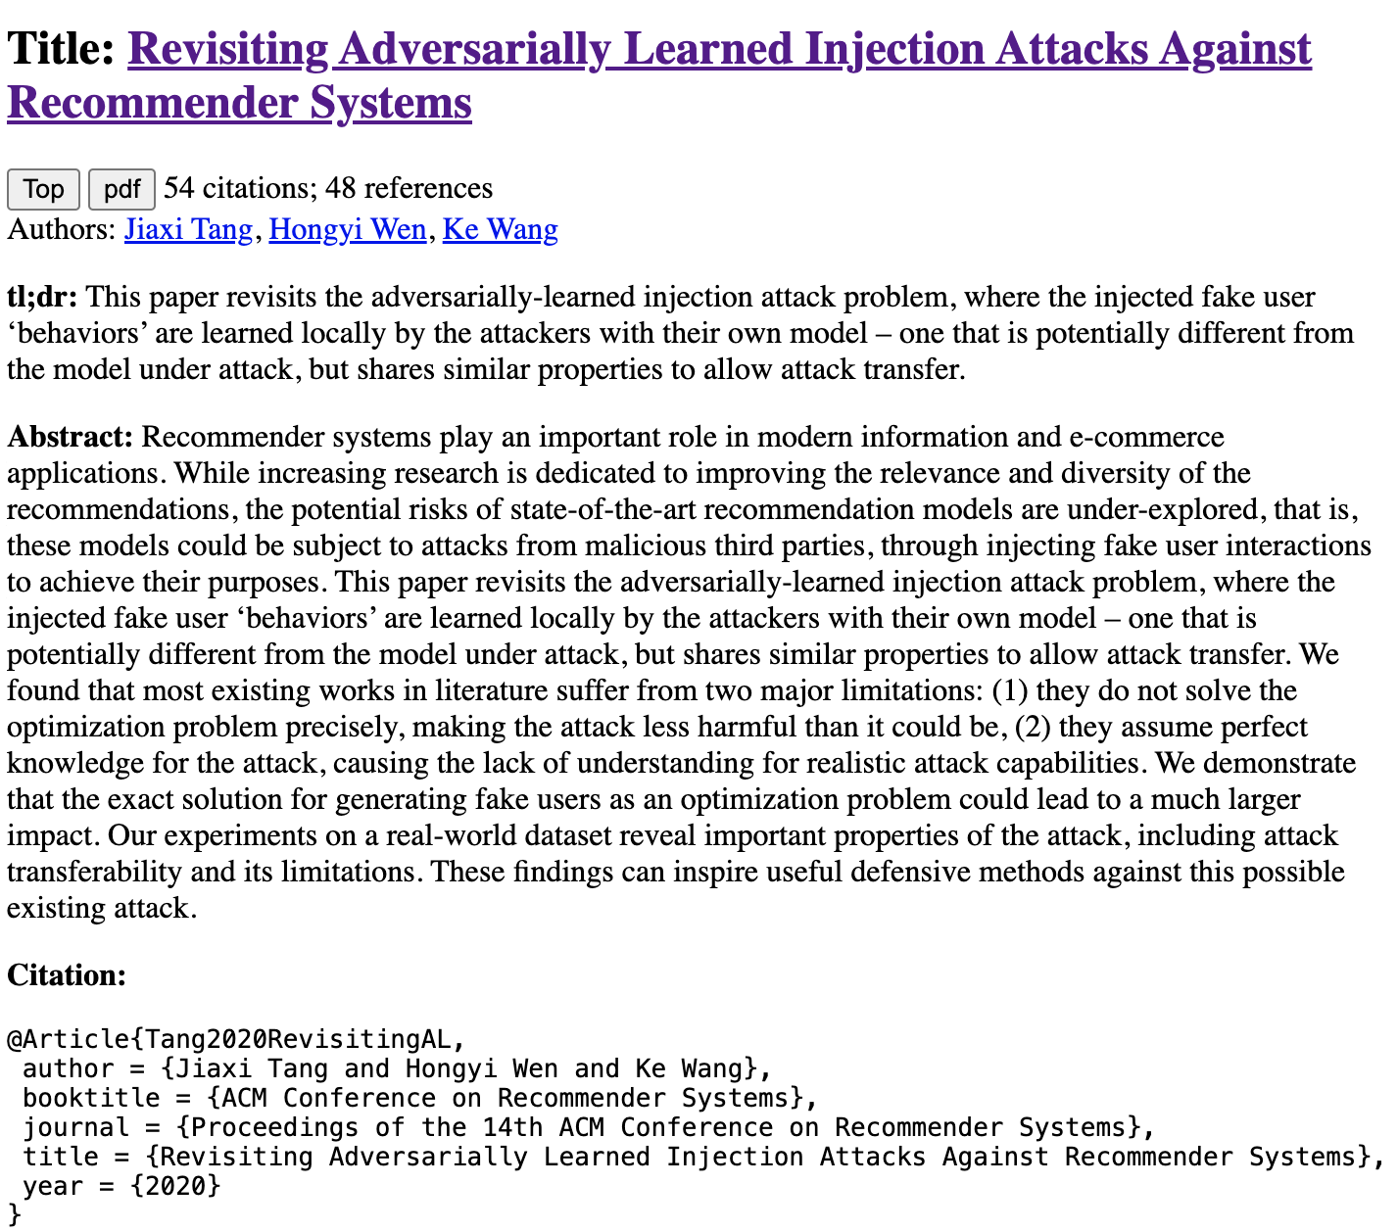
Compare and Contrast
Input: query + candidate
Use prompts (chatbots)
Summary of candidate
Similarities of query & candidate
Differences of query & candidate

Slide 21
Output from Chatbot
Similarities
Differences
As an Assistant, I can tell you that both "Revisiting Adversarially Learned Injection Attacks Against Recommender Systems" and "Defense Against Model Extraction Attacks on Recommender Systems" focus on security aspects of recommender systems. The first paper explores injection attacks where the attacker manipulates the recommendation model by injecting malicious data, while the second paper deals with defending against model extraction attacks aimed at extracting sensitive information from the recommender system. Both papers highlight the importance of addressing security vulnerabilities in recommender systems to protect user data and maintain the integrity of the recommendation models.
"Revisiting Adversarially Learned Injection Attacks Against Recommender Systems" focuses on exploring adversarially learned injection attacks against recommender systems, where the attacker has knowledge about the dataset used to train the target recommendation model. On the other hand, "Defense Against Model Extraction Attacks on Recommender Systems" focuses on strategies to defend against model extraction attacks, where attackers try to extract the architecture or parameters of a recommender system. The former paper deals with adversarial attacks, while the latter focuses on defense mechanisms against a different type of attack.

Slide 22
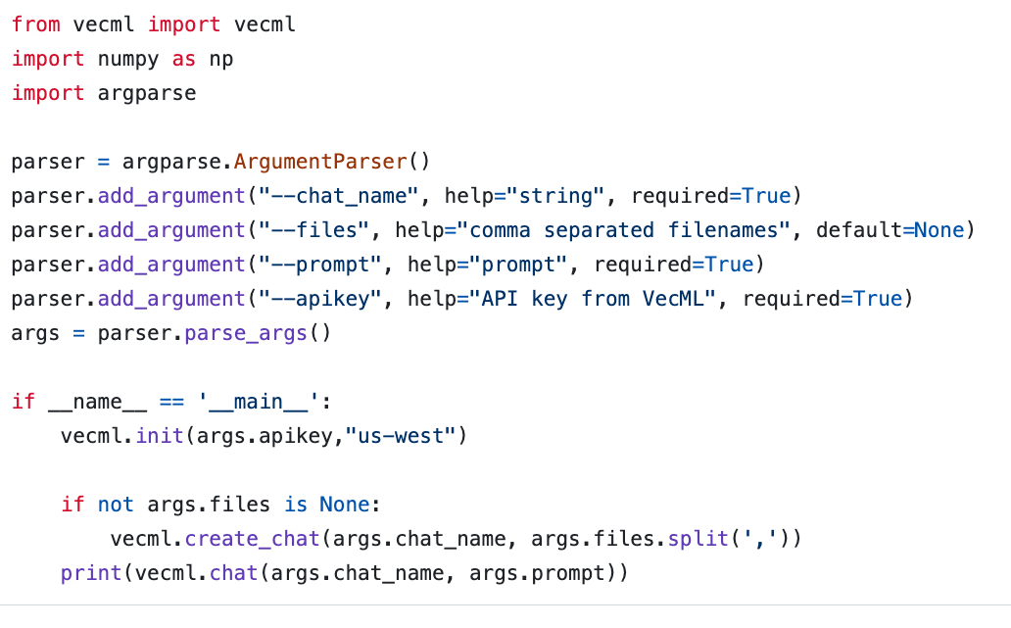
Chatbots are Super-Easy www.vecml.com

Slide 23
Decomposing a big problem into subtasks

Slide 24
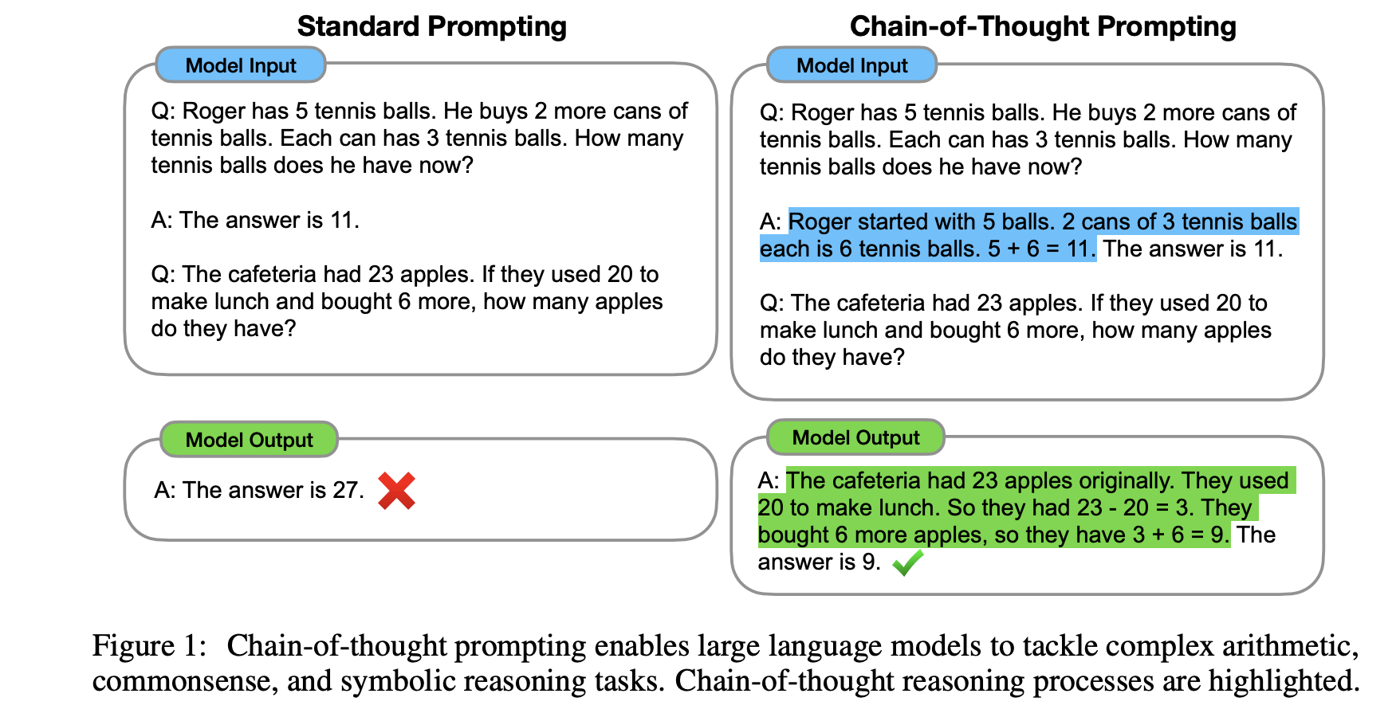

Slide 25
Limitations
Decomposing Problems
Hypothetical
Chain-of-Thought Prompting
works because...
ChatGPT needs help decomposing problems into subtasks
Suppose ChatGPT
can add two small numbers
But for large numbers,
it makes up answers
After each release,
“small” gets “bigger”
(We will return to this later)

Slide 26
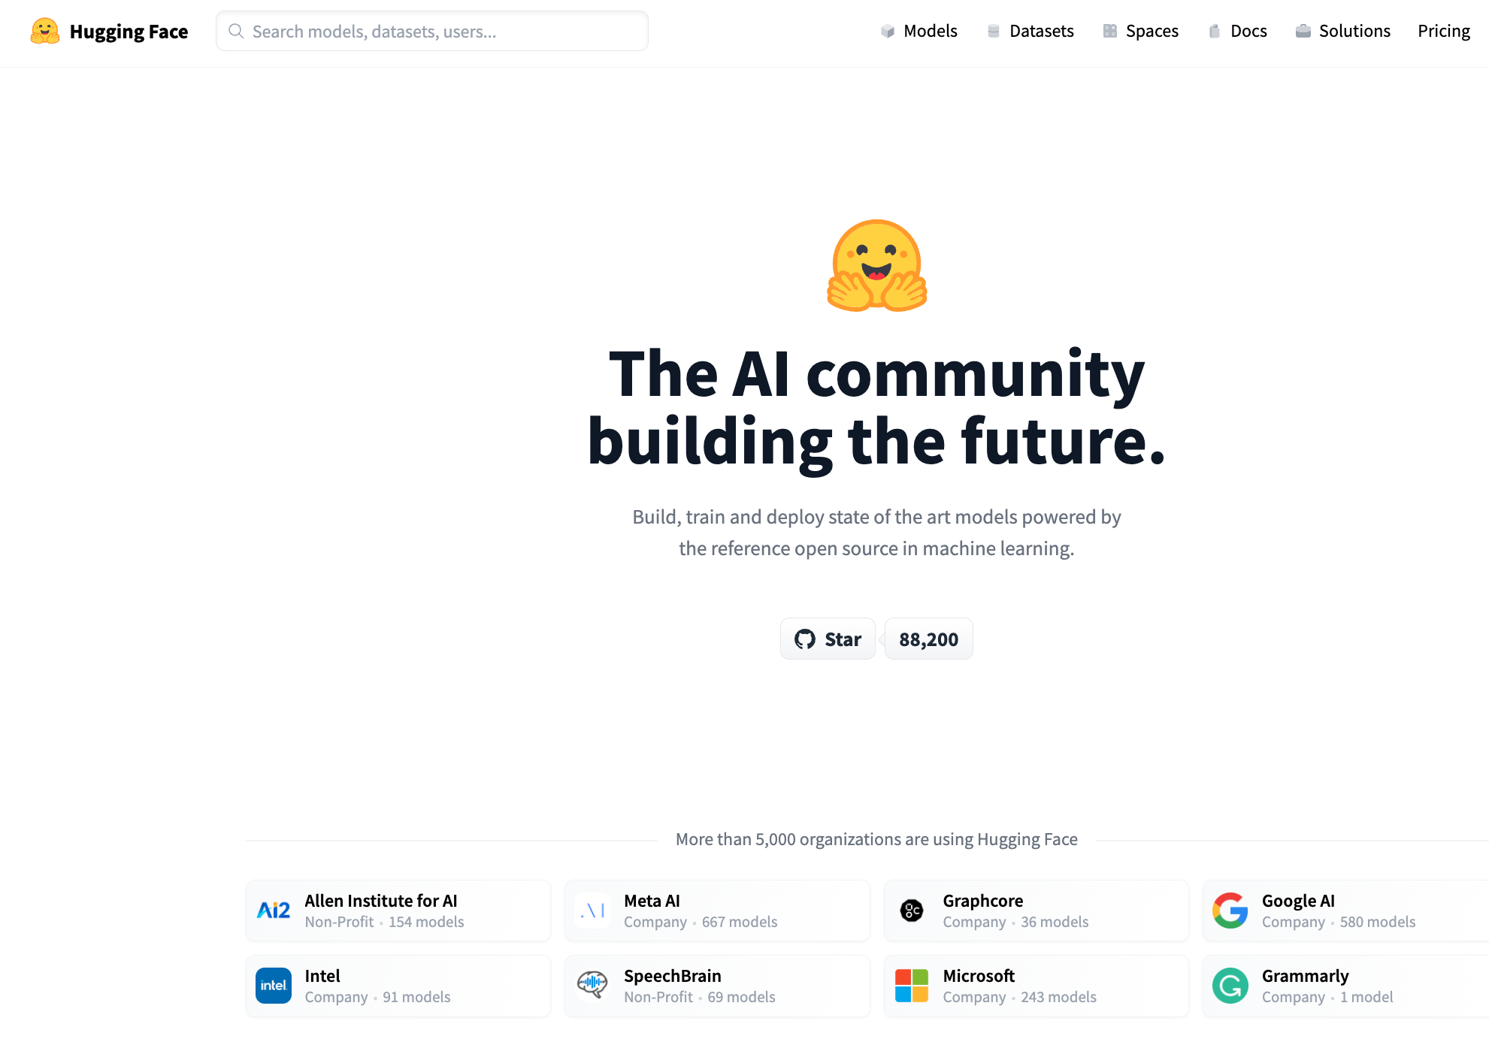




Resources
DataSets (Benchmarks)
Hubs
Examples
GLUE (NYU)
SQuAD (Stanford)
Features
Splits:
Test, Validation (Dev), Train
Metrics
Leaderboard
Examples
HuggingFace https://huggingface.co/
PaddleHub (Baidu, China)
Features
Datasets (50k)
Models (300k)
Apps (100k)
Community Engagement
(Social Media)
Growing Quickly
($≈10$x/year)

Slide 27
Prompt Engineering
In-context learning
New capabilities can be unlocked in LLMs
LLM is prompted with a few in-context demonstrations
Learns to perform a certain task
Task performance is very sensitive to prompts

Slide 28
Prompt structure
Relevance evaluation task
Task instructions
You are a search quality rater evaluating relevance of web pages
Query-document pair to be labelled
Query {query}
Document {document}
Relevant?
Re-state the task
Output format

Slide 29
Standard 3-Step Recipe
Step | Description | Time | Hardware
1
2
3 | Inference (predict) | Seconds/Minutes | 0+ GPUs
Easy

Slide 30
Standard 3-Step Recipe
Most users should not do this themselves
Step | Description | Time | Hardware
1 | Pre-Training | Days/Weeks | Large GPU cluster
2
3 | Inference (predict) | Seconds/Minutes | 0+ GPUs

Slide 31
Standard 3-Step Recipe
Step | Description | Time | Hardware
1 | Pre-Training | Days/Weeks | Large GPU cluster
2 | Fine-Tuning (fit) | Hours/Days | 1+ GPUs
3 | Inference (predict) | Seconds/Minutes | 0+ GPUs
Not Hard

Slide 32
Inference (predict)

Slide 33
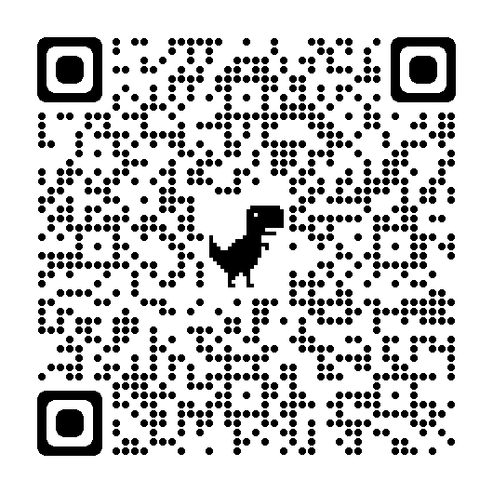
Easy: Inference (Colab) HuggingFace Pipelines
See here for a list of currently supported tasks
machine learning:
classification, regression,
token classification,
classify spans (Q&A), fill mask
speech:
speech-to-text (automatic speech recognition (ASR)),
text-to-speech (speech synthesis)
audio classification
vision:
image classification, video classification, image segmentation, image to text, visual question answering
natural language:
text classification
question answering
fill mask (Cloze task)
machine translation (MT)
feature extraction

Slide 34
“Easy Inference”
Replication
Plenty of Room for Improvement
Many students should be able to
Download models from hubs
And use them as intended
To do many useful things
Especially on first impression,
It is impressive how much
can be accomplished
with “easy inference”
But there is always
more work to do
Current solutions are
unlikely to stand up to test of time

Slide 35
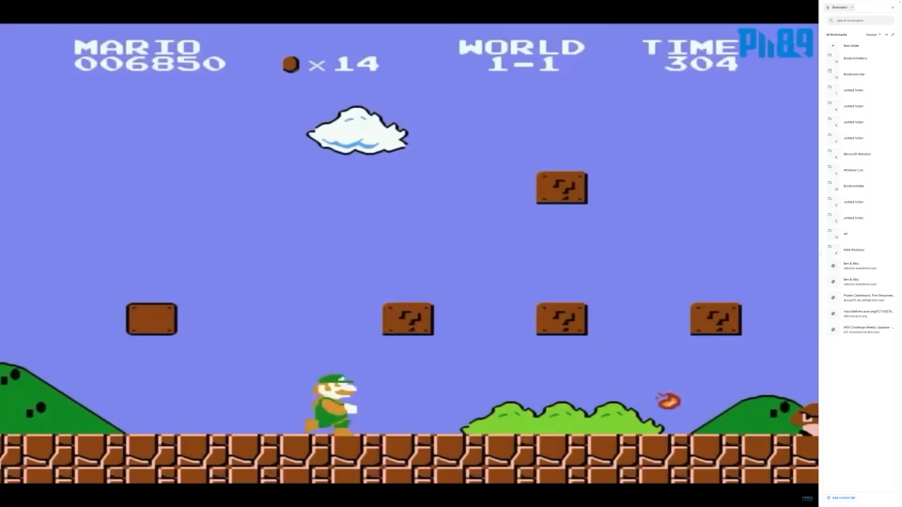
Test of time: Inference is cool (for now)
https://youtu.be/rLl9XBg7wSs

Slide 36

Test of time: Inference is cool (for now) Will you still love me when I’m Sixty Four?
https://www.youtube.com/watch?v=wUDRIC5RSX4

Slide 37
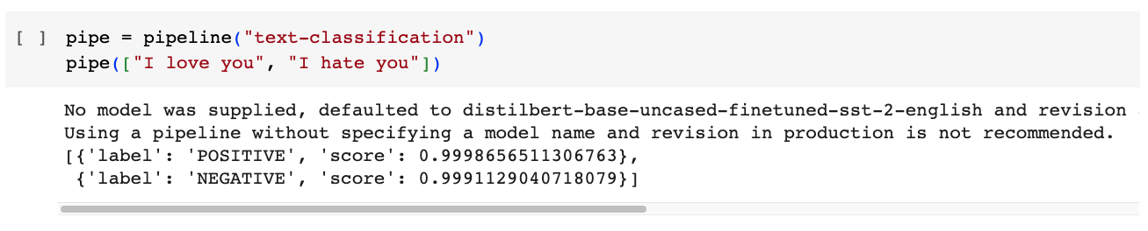
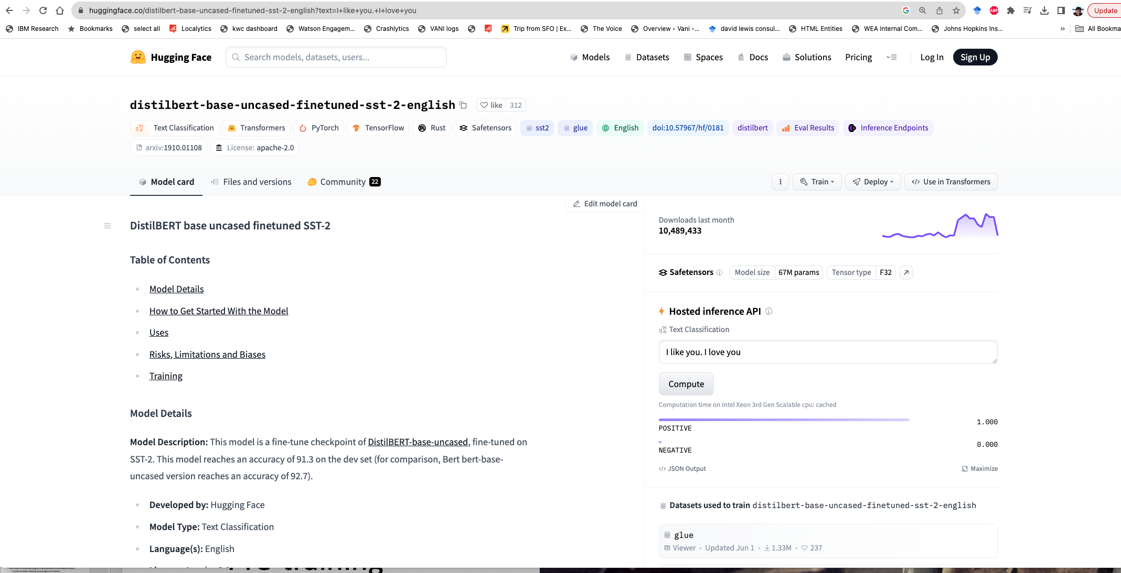
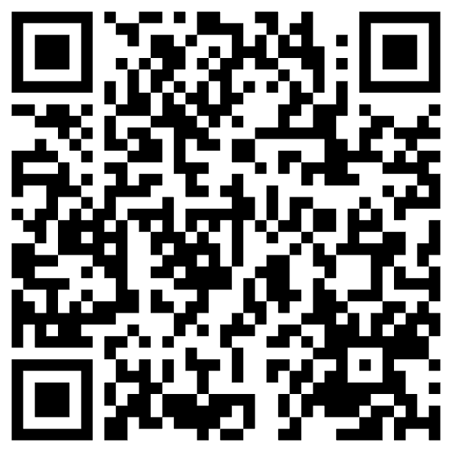

Slide 38
Input: I love you Output: Depends on Model (among other things)
Task: classify
Models:
Sentiment
Expected output label: positive
Fake News:
Expected output label: not fake (real)
Spam/Ham:
Expected output label: not spam (ham)
for model in …
do
echo I love you |
gft_predict \
--task classify \
--model $model
done

Slide 39
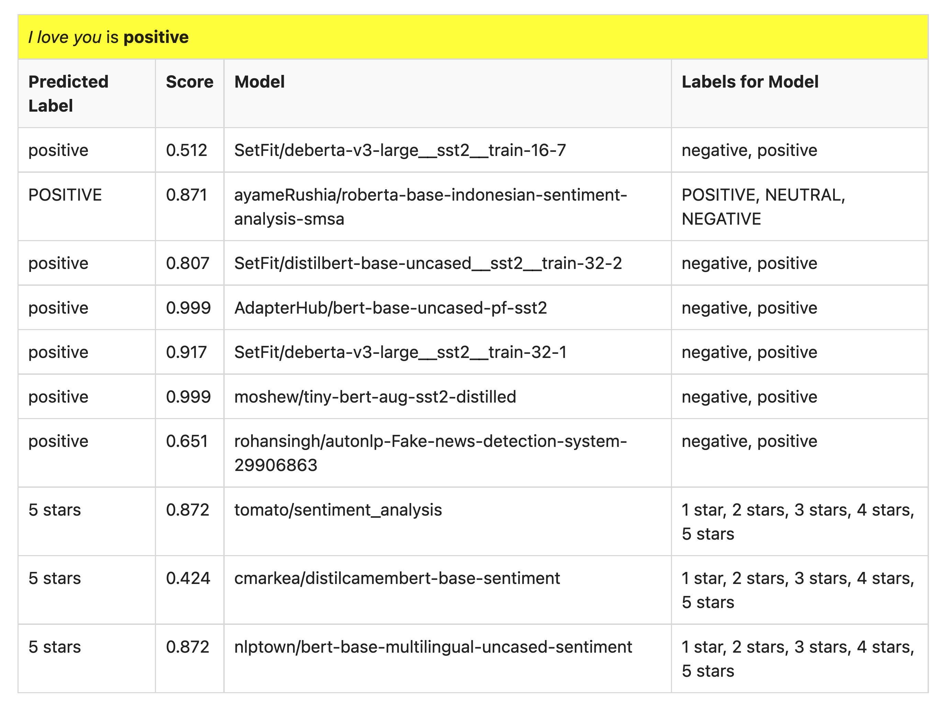
Many of these models produce reasonable results
Scores could be more confident

Slide 40
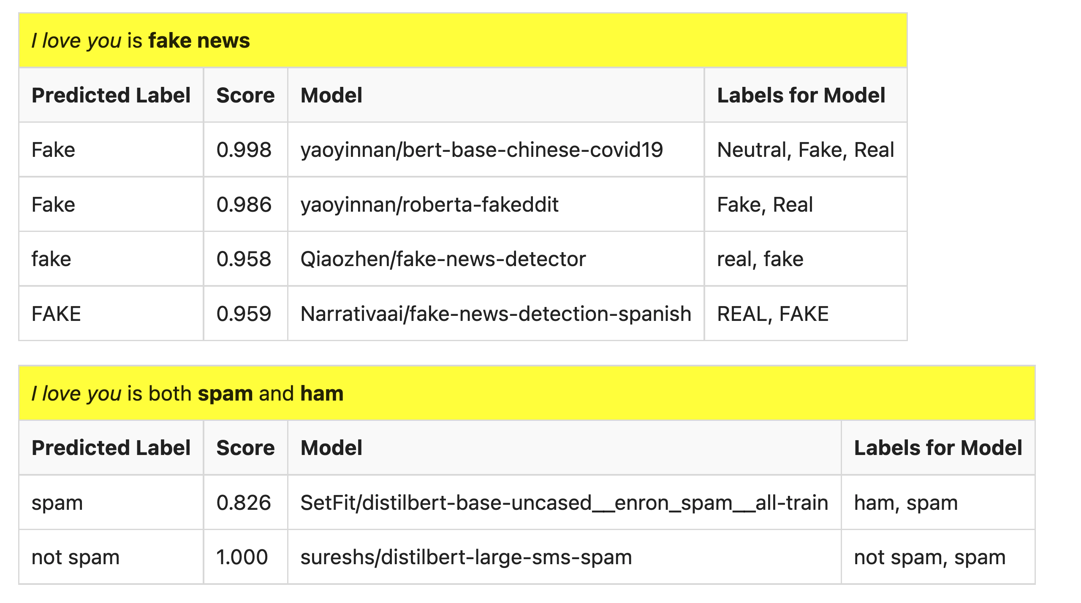
But…

Slide 41

What is a label?
Spam email?
Label: yes, no

Slide 42
Ugly: Challenges for Classification
Benchmarks are small, clean, unrealistic…
Arms race, Adversarial attacks (GANs),
Labeling is not as easy as it might seem
Depends on context
Consider: adult content
Parents posted innocent videos of their kids on YouTube
But these videos went viral among not-so-innocent audience
Incentives:
If toxicity is profitable,
then use classifiers in reverse direction
to maximize toxicity (and profits)

Slide 43
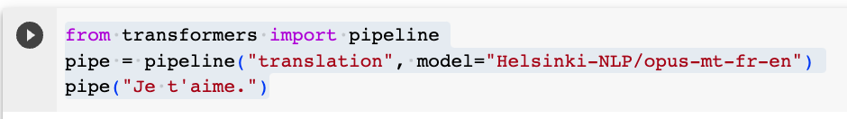
Another Example of Inference: Machine Translation (MT)

Slide 44
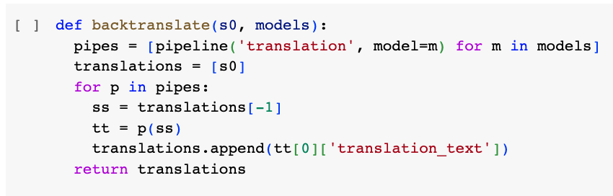
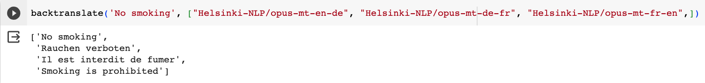
Back Translation

Slide 45
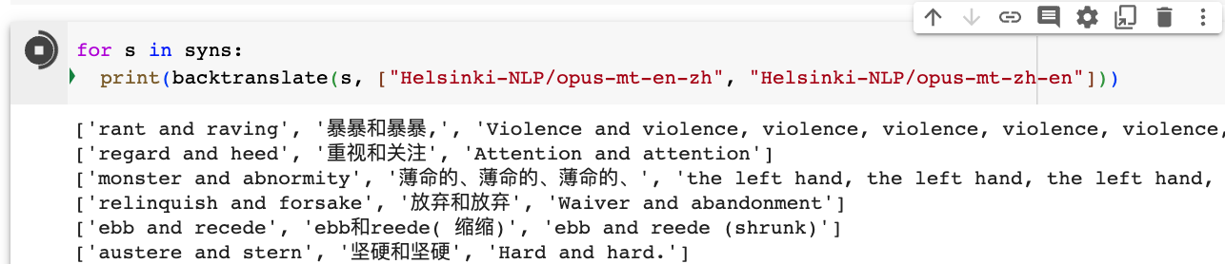
Back Translation of Synonyms

Slide 46
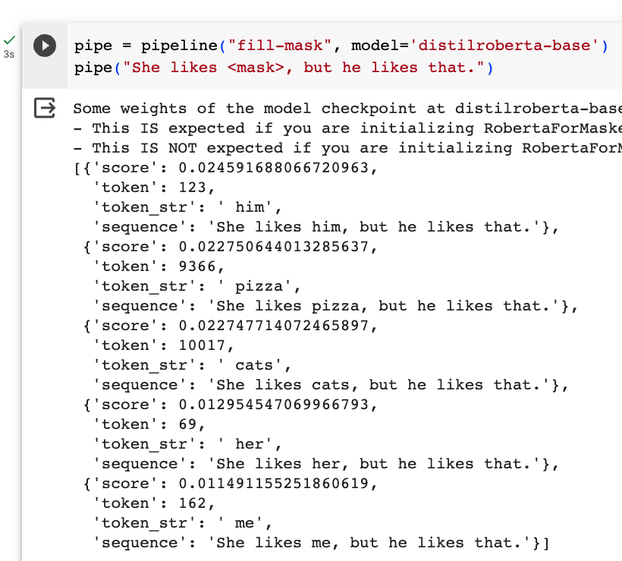
Fill Mask (Cloze Task)

Slide 47
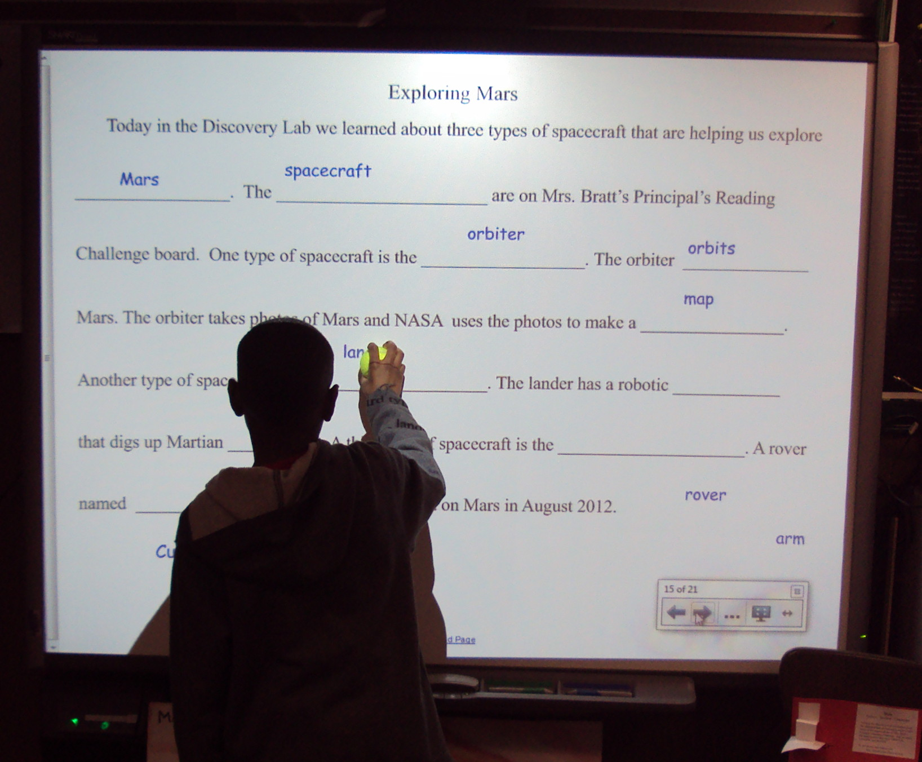
More Inference Tasks: Classification, Fill Mask, … echo … | gft_predict –task fill-mask
BERT: Fill-Mask (Delvin et al, 2019)
Cloze Task (1953)
Input | Choice 1 |  | Choice 2
I <mask> you | miss | 30% | love | 17%
I <mask> him | love | 14% | miss | 13%
I <mask> her | love | 16% | miss | 12%
I love <mask> | him | 2% | cats | 2%
I <mask> New York | love | 33% | miss | 17%
I love the <mask> guy | pizza | 2% | funny | 2%
I hate the <mask> guy | fucking | 3% | pizza | 2%
By Laurie Sullivan - DSC01784, CC BY 2.0, https://commons.wikimedia.org/w/index.php?curid=62727253

Slide 48
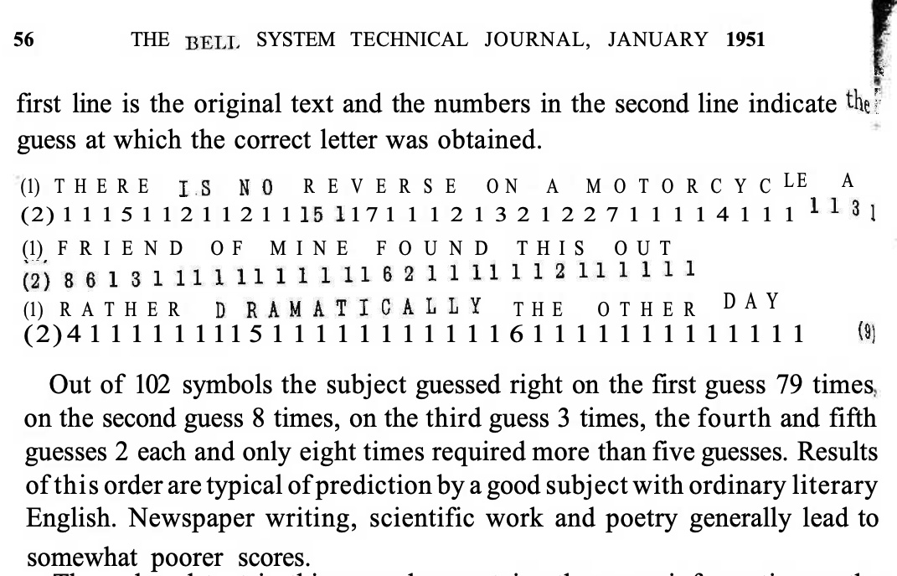
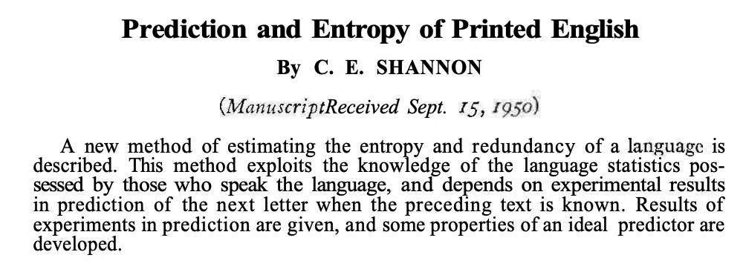
Lots of History: Fill-mask, Cloze Task, Entropy

Slide 49
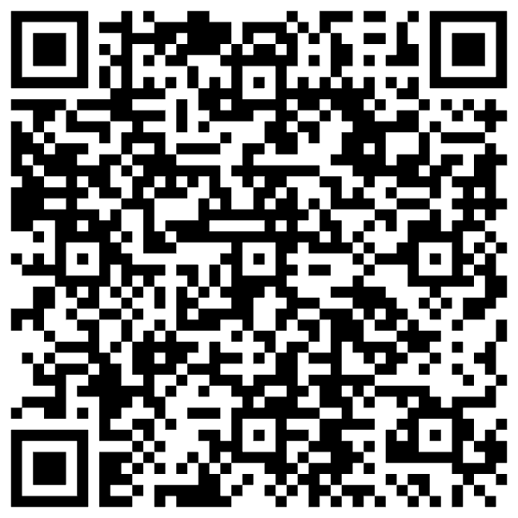
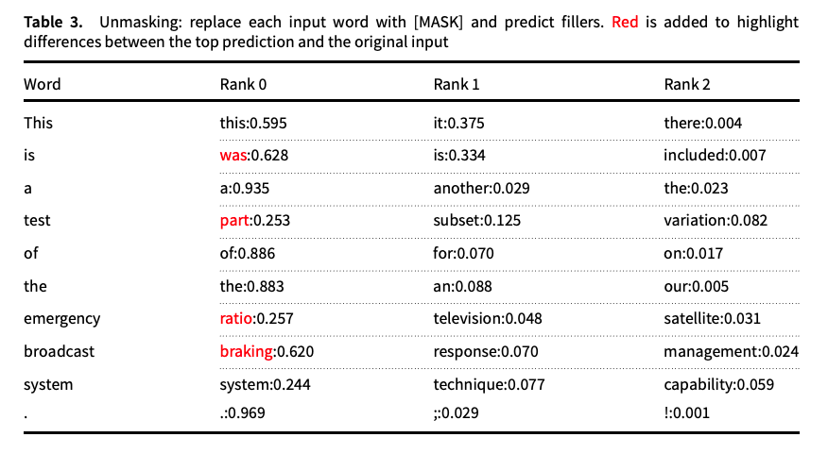
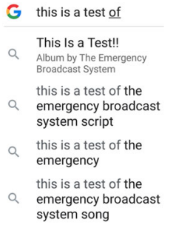
Guess the missing word in a cliché (from “Emerging trends: Deep nets for poets”)
Fill Mask
Autocomplete in Search

Slide 50
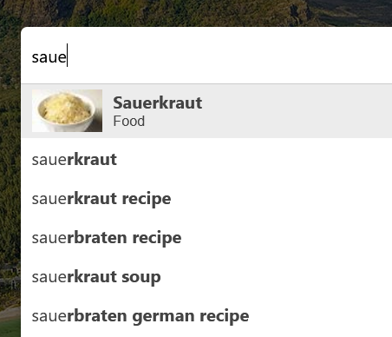
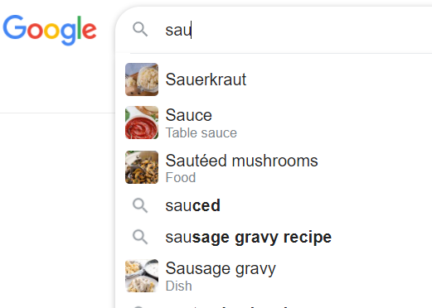

Autocomplete $≠$ Fill-Mask

Slide 51
Massive Growth → Mistaken Impression that everything is new (and there is no history)
Scientific literature doubles every 9 years (90% written since I started PhD)
What’s new
The world is taking notice (in AI)
Fluency is much improved
What’s not new
Chatbots (and much of the tech)
SOTA-Chasing
New/better shiny objects
(with same old quality?)
Does SOTA-Chasing → Progress?
Trustworthiness is still open

Slide 52
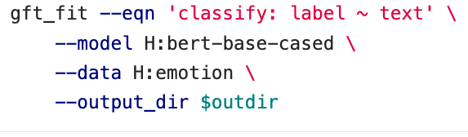
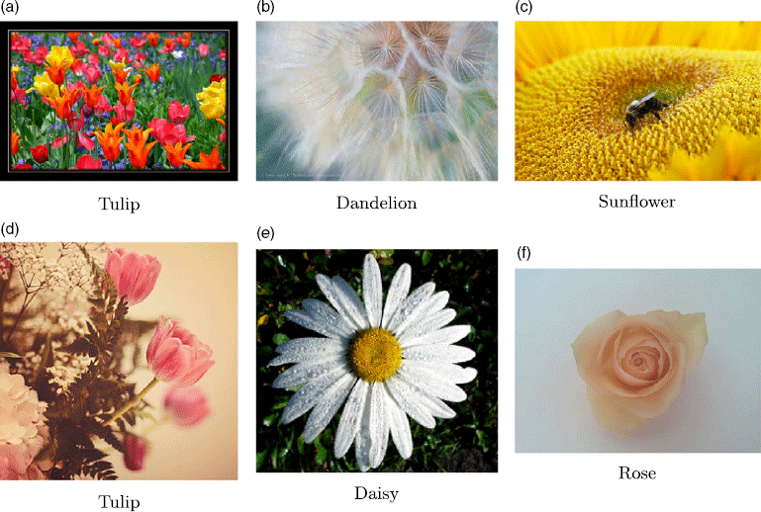
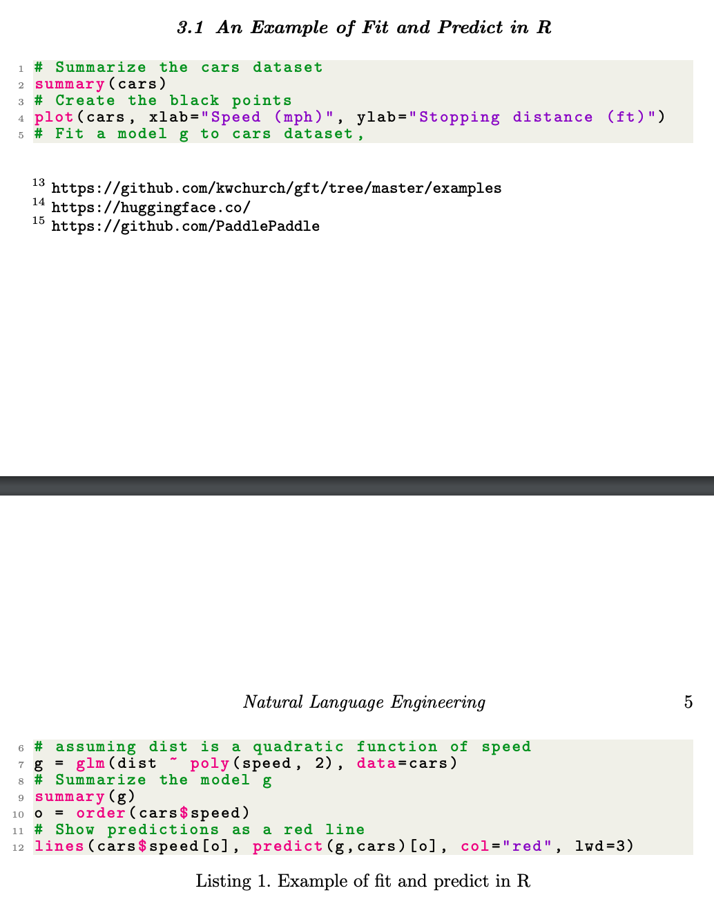
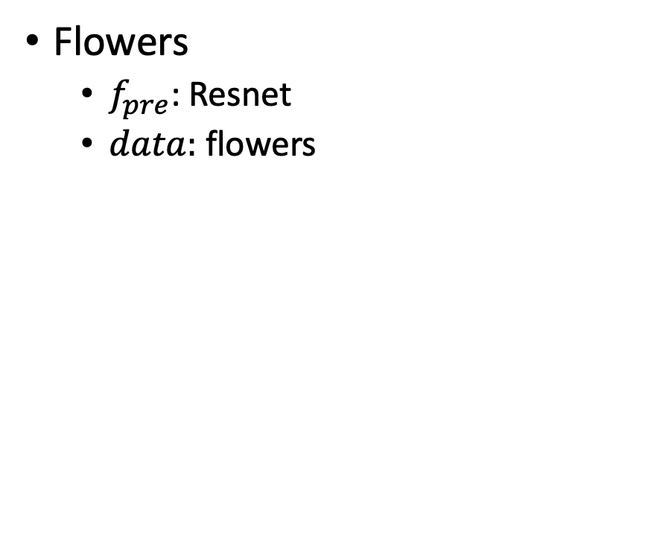
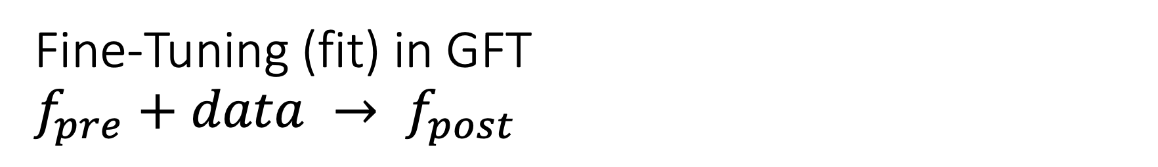
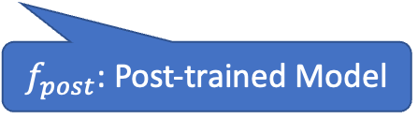
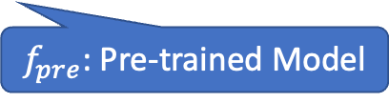
Fine-Tuning (fit) in GFT $f_{pre}+data → f_{post}$
Flowers
$f_{pre}$: Resnet
$data:$flowers
$f_{pre}$: Pre-trained Model
$f_{post}$: Post-trained Model
Fine-Tuning (fit) in R

Slide 53

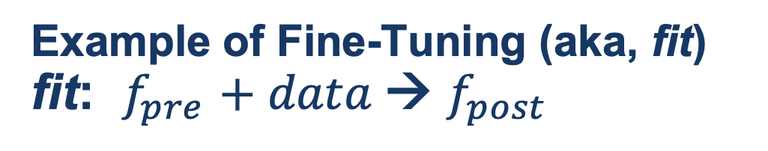
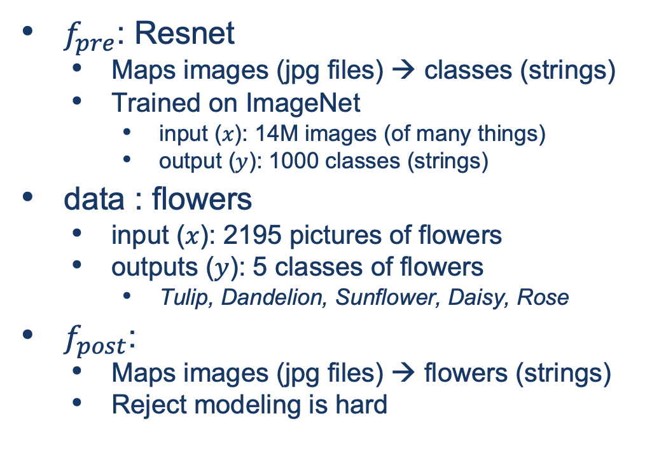
Guide Book App

Slide 54
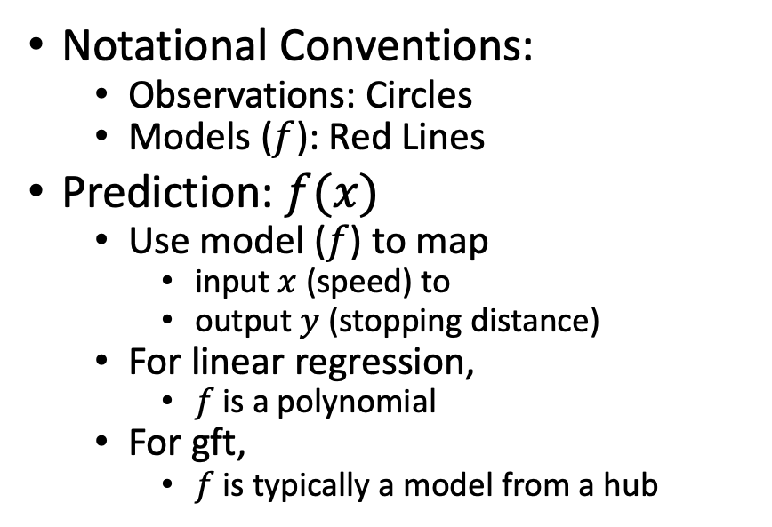
Fine-Tuning (Fit) in R (Statistics Package)
Make deep nets look like regression
(Not much programming)
Black Points:
cars dataset
Notational Conventions:
Observations: Circles
Models ($f$): Red Lines
Prediction: $f(x)$
Use model ($f$) to map
input $x$ (speed) to
output $y$ (stopping distance)
For linear regression,
$f$is a polynomial
For gft,
$f$is typically a model from a hub
Red Line:
Model (f)

Slide 55
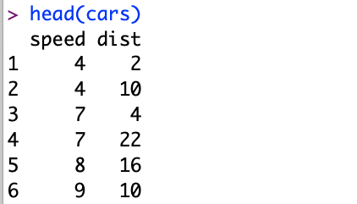
Datasets Example: Cars
Two Columns:
cars$speed
cars$dist

Slide 56
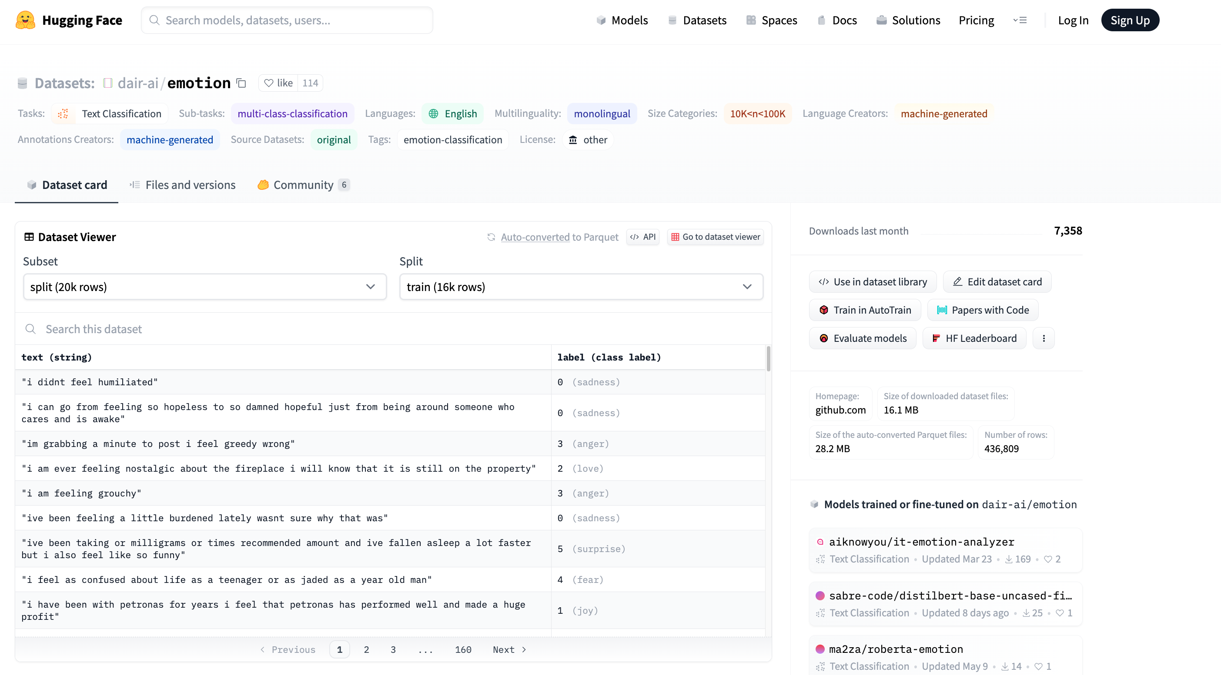


Example of Datasets in HuggingFace https://huggingface.co/datasets/dair-ai/emotion
$$x$$
$$y$$

Slide 57
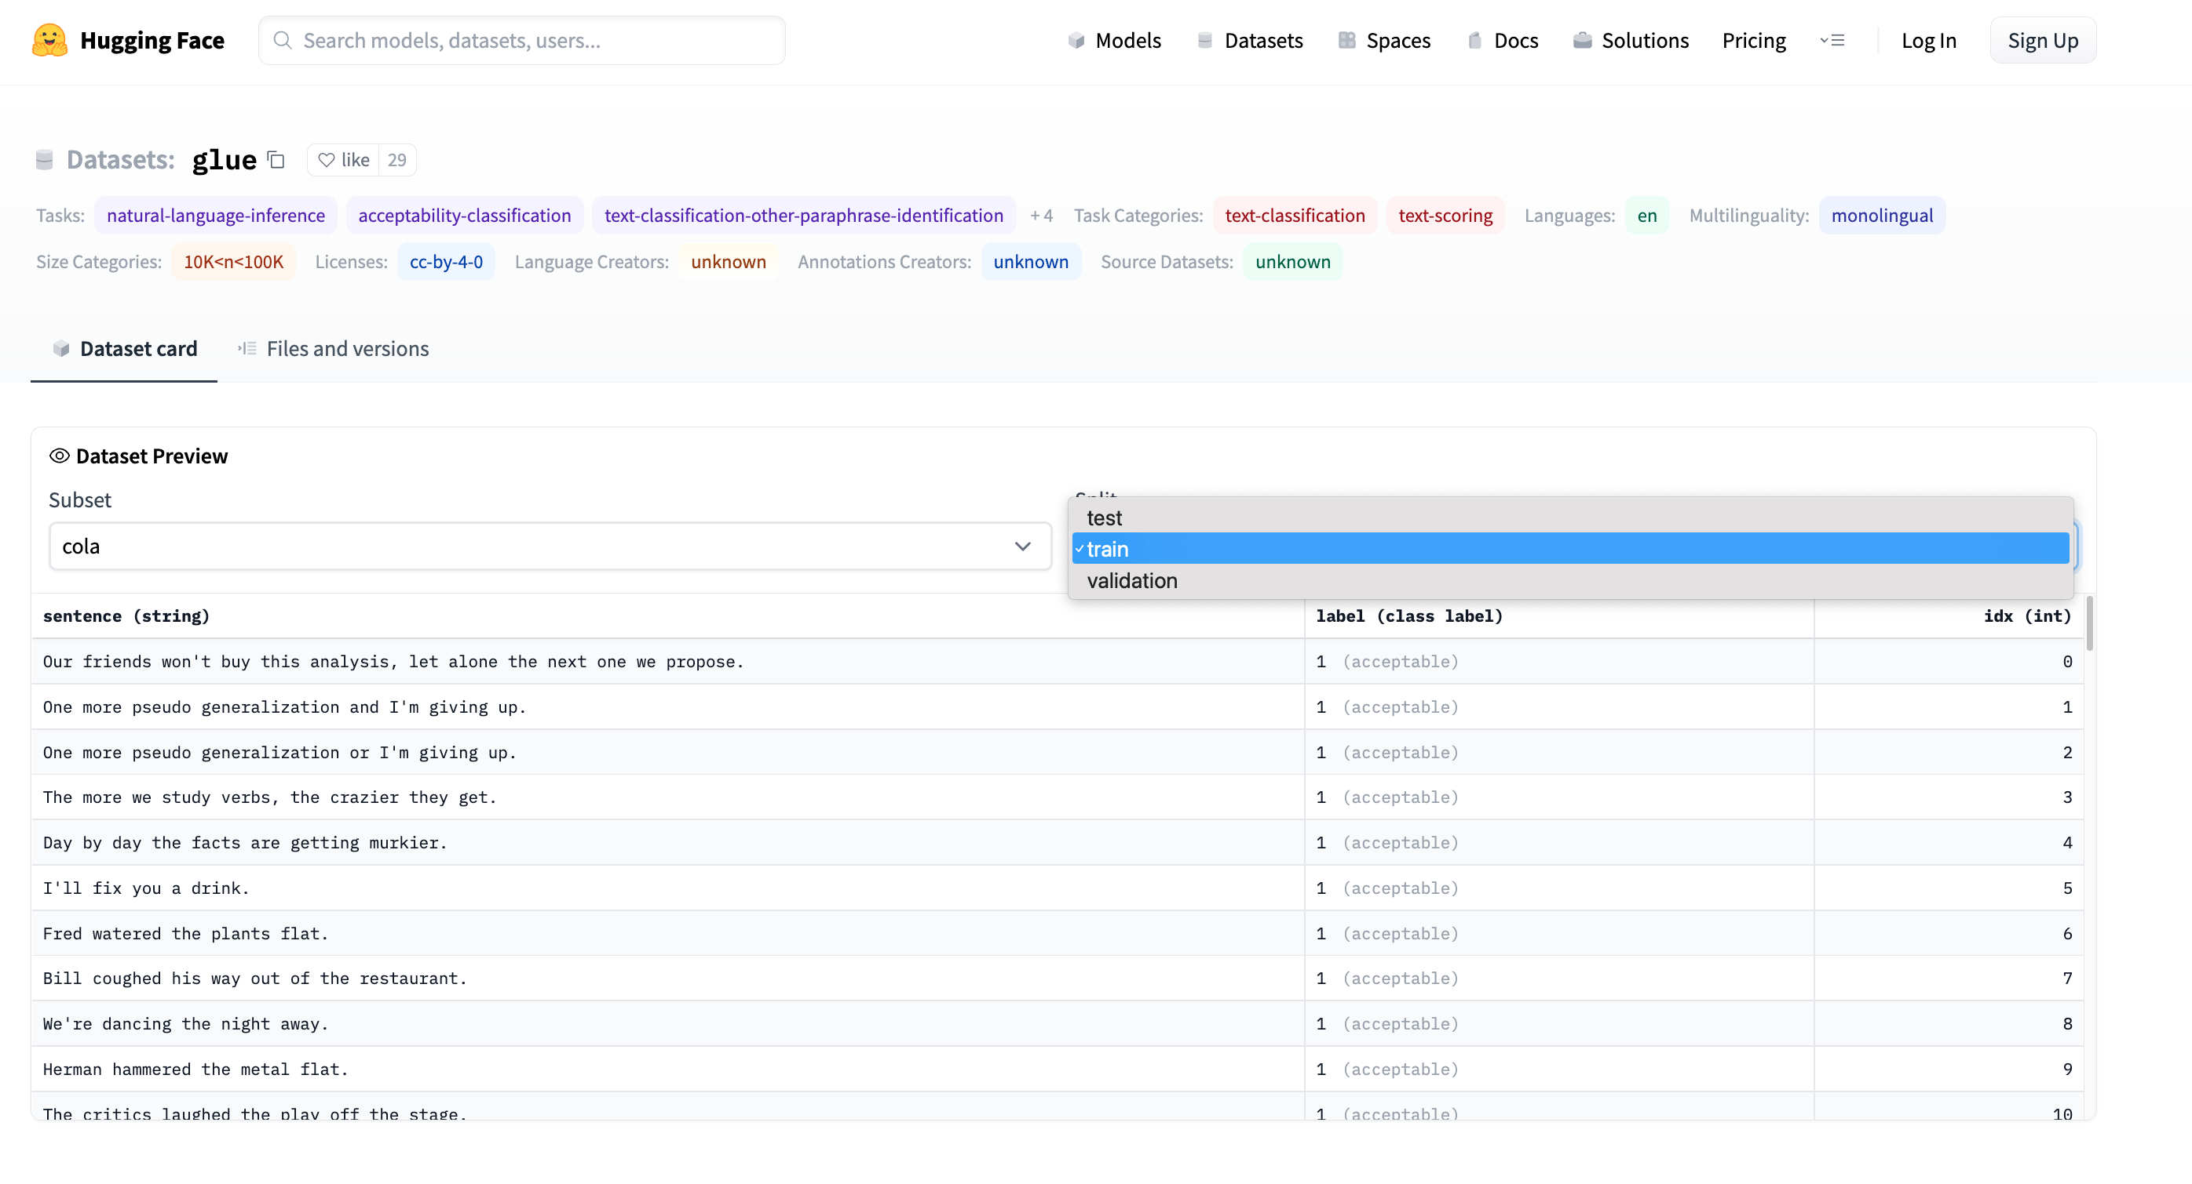
Emotion → GLUE (Cola) https://huggingface.co/datasets/glue/viewer/cola/train
Terminology: Splits
Terminology: Subset

Slide 58
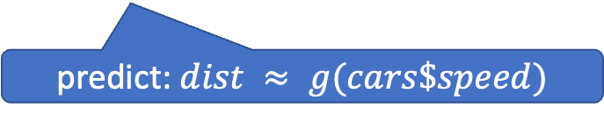
glm (General Linear Models) in R (and Sklearn)
glm: fit poly model with data
predict: $dist ≈ g(cars\$speed)$

Slide 59
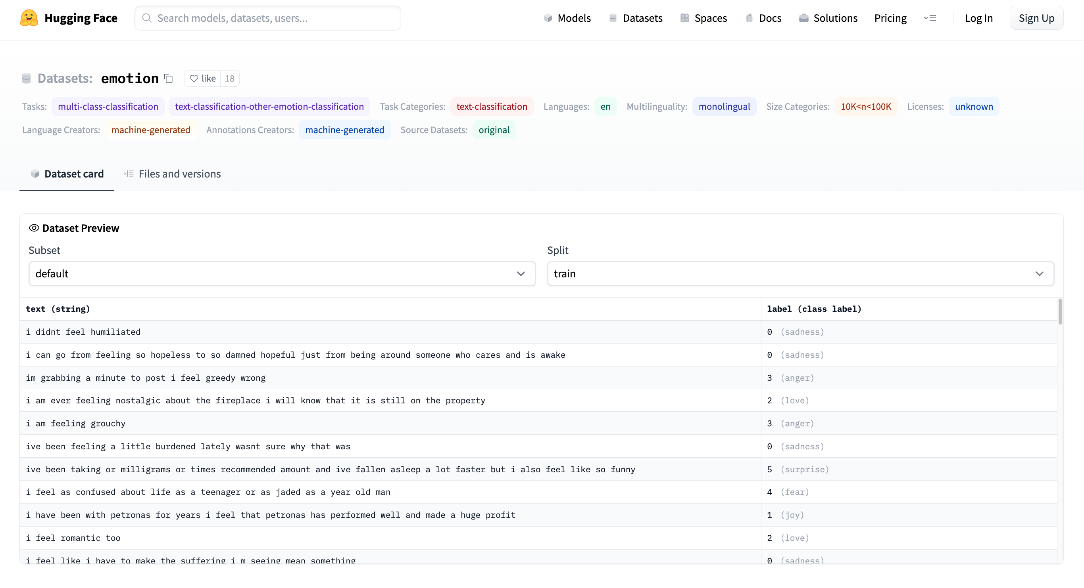
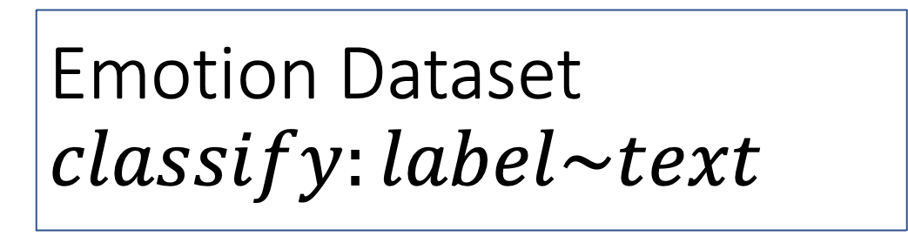
Emotion Dataset $$classify:label\sim text$$
Task/Loss
Columns
Columns
Row

Slide 60
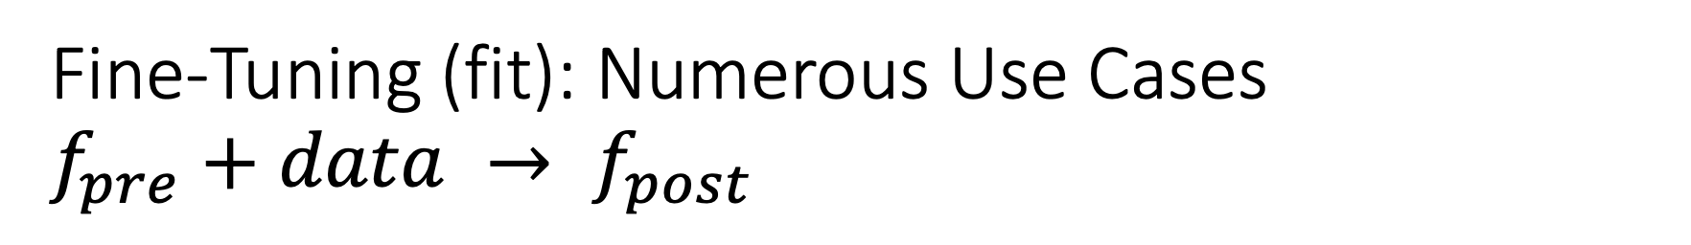

Fine-Tuning (fit): Numerous Use Cases $f_{pre}+data → f_{post}$
Flowers
$f_{pre}$: Resnet
$data:$flowers
Emotion Classification
$f_{pre}$: https://huggingface.co/bert-base-uncased
$data:https://huggingface.co/datasets/dair−ai/emotion$
GLUE
SQuAD
Machine Translation
Speech Recognition
Vision
and much more
$f_{pre}$: Pre-trained Model
$f_{post}$: Post-trained Model
Fine-Tuning (fit) in R

Slide 61
GLUE Subsets
GLUE COLA SUBSET
Sentence | Label
Bill sang himself to sleep. | 1 (acceptable)
Bill squeezed the puppet through the hole. | 1 (acceptable)
Bill sang Sue to sleep. | 1 (acceptable)
The elevator rumbled itself to the ground. | 0 (unacceptable)
If the telephone rang, it could ring itself silly. | 1 (acceptable)
She yelled hoarse. | 0 (unacceptable)
Ted cried to sleep. | 0 (unacceptable)
The tiger bled to death. | 1 (acceptable)
Subset | Dataset
COLA | H:glue,cola
SST2 | H:glue,sst2
WNLI | H:glue,wnli
MRPC | H:glue,mrpc
QNLI | H:glue,qnli
QQP | H:glue,qqp
SSTB | H:glue,sstb
MNLI | H:glue,mnli

Slide 62

GFT Program for COLA
GLUE COLA SUBSET
Sentence | Label
Bill sang himself to sleep. | 1 (acceptable)
Bill squeezed the puppet through the hole. | 1 (acceptable)
Bill sang Sue to sleep. | 1 (acceptable)
The elevator rumbled itself to the ground. | 0 (unacceptable)
If the telephone rang, it could ring itself silly. | 1 (acceptable)
She yelled hoarse. | 0 (unacceptable)
Ted cried to sleep. | 0 (unacceptable)
The tiger bled to death. | 1 (acceptable)
https://github.com/kwchurch/gft/blob/master/examples/fit_examples/model.HuggingFace/language/data.HuggingFace/glue/cola.sh

Slide 63

Simple Equations Cover Many Cases of Interest GLUE: A Popular Benchmark
Subset | Dataset | Equation
COLA | H:glue,cola | $$classify : label \sim sentence$$
SST2 | H:glue,sst2 | $$classify : label \sim sentence$$
WNLI | H:glue,wnli | $$classify : label \sim sentence$$
MRPC | H:glue,mrpc | $$classify : label \sim sentence1 + sentence2$$
QNLI | H:glue,qnli | $$classify : label \sim sentence1 + sentence2$$
QQP | H:glue,qqp | $$classify : label \sim question+sentence$$
SSTB | H:glue,sstb | $$regress : label \sim question1+question2$$
MNLI | H:glue,mnli | $$classify : label \sim premise+hypothesis$$

Slide 64


Equation Keywords $≈$ Pipeline Tasks
Benchmark | Subset | Dataset | Equation
GLUE | COLA | H:glue,cola | $$classify : label \sim sentence$$
SQuAD 1.0 |  | H:squad | $$classify_spans:answers\sim question+context$$
SQuAD 2.0 |  | H:squad_v2 | $$classify_spans:answers\sim question+context$$
CONLL2003 | POS | H:conll2003 | $$classify_tokens:pos_tags\sim tokens$$
 | NER | H:conll2003 | $$classify_tokens:ner_tags\sim tokens$$
TIMIT |  | H:timit_asr | $$ctc :text\sim audio$$
Amazon Reviews |  | H:amazon_reviews_multi | $$classify : label \sim question+sentence$$
VAD |  | C:$gft/datasets/VAD/VAD | $$regress: Valence + Arousal + Dominance \sim Word$$

Slide 65


gft Cheat Sheet (General Fine-Tuning)
4+1 Functions
4 Arguments
gft_fit: $f_{pre}$ →$f_{post}$(fine-tuning)
4 Arguments, --output_dir, --metric, --splits
(plus most args in most hubs)
gft_predict: $f\left(x\right)→\hat{y}$ (inference)
Input: 4 Arguments ($x$ from data or stdin)
Output: $\hat{y}$ for each $x$
gft_eval: Score model on dataset
Input: 4 Arguments, --split, --metric, …
Output: Score
gft_summary: Find good stuff
Input: 4 Arguments
(may include: __contains__, __infer__)
gft_cat_dataset: Output data to stdout
Input: 4 Arguments (--data, --eqn)
--data
--model
--eqn $task:y\sim x_{1}+x_{2}$
--task
classify (text-classification)
classify_tokens (token-classification)
classify_spans (QA, question-answering)
classify_audio (audio-classification)
classify_images (image-classification)
regress
text-generation
MT (translation)
ASR (ctc, automatic-speech-recognition)
fill-mask

Slide 66

Regression in R: Summarize (almost) anything
Fit a model (g) to data (cars)

Slide 67

Regression in R: Summarize (almost) anything

Slide 68
Regression in R: Summarize (almost) anything
Fit a model (g) to data (cars)
Predict
Summarize a model (g)
Opportunity to Improve g

Slide 69
gft_summary
Summarize almost anything
Models
Datasets

Slide 70





Tasks
$$y∈\left\{0,1,2,…\right\}$$
classify, text-classification
regress
QA, Question Answering, classify spans
token classification
NER (Named Entity Recognition)
POS (Part of Speech Tagging)
translation, MT
ASR, Automatic Speech Recognition, ctc
$y∈ℝ$ or $y∈ℝ^{N}$
$y$ for each start/end of span
$y$ for each token
$y$ for each phoneme

Slide 71

gft Cheat Sheet (General Fine-Tuning)
4+1 Functions
4 Arguments
gft_fit: $f_{pre}$ →$f_{post}$(fine-tuning)
4 Arguments, --output_dir, --metric, --splits
(plus most args in most hubs)
gft_predict: $f\left(x\right)→\hat{y}$ (inference)
Input: 4 Arguments ($x$ from data or stdin)
Output: $\hat{y}$ for each $x$
gft_eval: Score model on dataset
Input: 4 Arguments, --split, --metric, …
Output: Score
gft_summary: Find good stuff
Input: 4 Arguments
(may include: __contains__, __infer__)
gft_cat_dataset: Output data to stdout
Input: 4 Arguments (--data, --eqn)
--data
--model
--eqn $task:y\sim x_{1}+x_{2}$
--task
classify (text-classification)
classify_tokens (token-classification)
classify_spans (QA, question-answering)
classify_audio (audio-classification)
classify_images (image-classification)
regress
text-generation
MT (translation)
ASR (ctc, automatic-speech-recognition)
fill-mask

Slide 72
Easy Conclusions: Inference (Colab) HuggingFace Pipelines
See here for a list of currently supported tasks
machine learning:
classification, regression,
token classification,
classify spans (Q&A), fill mask
speech:
speech-to-text (automatic speech recognition (ASR)),
text-to-speech (speech synthesis)
audio classification
vision:
image classification, video classification, image segmentation, image to text, visual question answering
natural language:
text classification
question answering
fill mask (Cloze task)
machine translation (MT)
feature extraction

